Slide 1
Understanding Kubernetes
[Session 1] Kubernetes Introduction

Slide 2
Topics
Three Evolutions in IT world
System Architecture: Monolithic -> SOA -> Microservice
Computing Technology: Physical -> VM -> Container
Computing Methodology: Centralized -> Distributed -> Cloud -> Cloud + Edge
Cloud Computing Building Blocks
Deep Dive in Containers
Introduction
Linux Namespaces
Cgroups
How Containers Work
Deep Dive in Container Orchestration
Introduction
Docker
Docker
Docker Swarm
Kubernetes
Docker Swarm vs Kubernetes
Pods
K8S Cluster Architecture
Control Plane Components
Node Components
Kubernetes (Cont…)
Add on components
Component interaction flow (Pod create)
K8s Installation
Hands On
Installation flow
Kubeadm init
Kubeadm join

Slide 3
Three Evolution in IT world

Slide 4
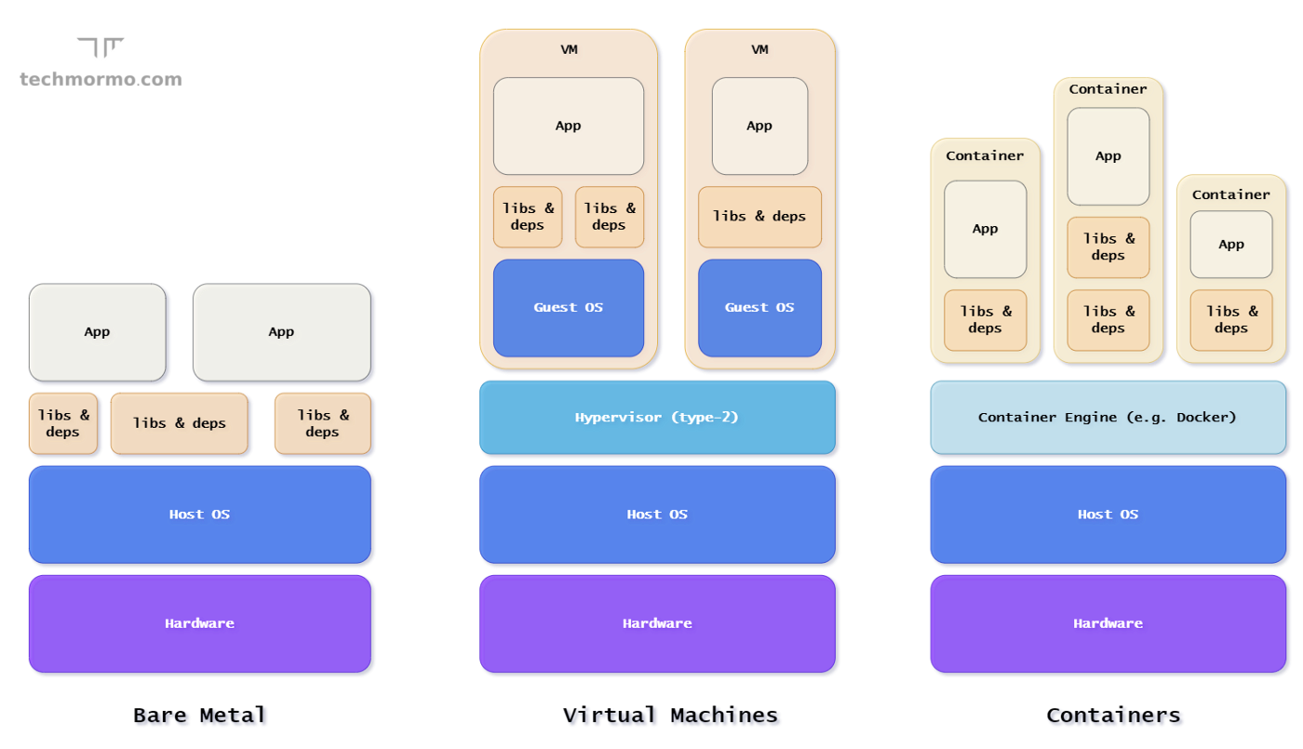
Computing Technology: Physical->VM->Container
Bare Metal: The traditional way of running an application was directly on dedicated hardware — i.e. one machine, one operating system (OS), one service/task.
Pros: Best performance. | Cons: Physical resources can be highly underutilized. Could not be partitioned easily for different teams/apps, and difficult to scale. Less security if multiple apps(may be different tenant) running at same place
Container: Containers virtualize just the operating system, instead of virtualizing the the entire physical machine like VMs. It allows you to securely run an application and its dependencies independently without impacting other containers or the operating system.
Pros: Highly Scalable. Lightweight and fast deployment. | Cons: Share the operating system.
VM: Virtualization is the technology that allows us to create & manage virtual resources that are isolated from the underlying hardware. A Hypervisor is a software that imitates a particular piece of computer hardware or the entire computer — allowing the available physical resources to be partitioned into multiple virtual ones, called Virtual Machines (VMs).
Pros: Good Security Hardware Cost Savings | Cons: Still slow. Scaling is still a problem.

Slide 5
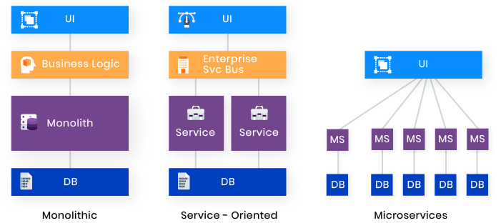
System Architecture: Monolithic -> SOA -> Microservice
Monolith: A monolithic pattern refers to a single indivisible unit. The concept of monolithic software lies in different components of an application being combined into a single program on a single platform. Usually, a monolithic app consists of a database, client-side user interface, and server-side application.
Pros: Simpler development and deployment Fewer cross-cutting concerns Better performance | Cons: Codebase gets cumbersome over time Difficult to adopt new technologies Limited agility
SOA: A service-oriented architecture (SOA) is a software architecture style that refers to an application composed of discrete and loosely coupled software agents that perform a required function. Follows “share-as-much-as-possible” architecture approach. SOA has two main roles: a service provider and a service consumer. Both of these roles can be played by a software agent. The concept of SOA lies in the following: an application can be designed and built in a way that its modules are integrated seamlessly and can be easily reused.
Pros: Reusability of services Better maintainability Higher reliability Parallel development | Cons: Complex management High investment costs Extra overload
Mirco service: A Microservice is a type of service-oriented software architecture that focuses on building a series of autonomous components that make up an app. Follows “share-as-little-as-possible” architecture approach. Unlike monolithic apps built as a single indivisible unit, microservice apps consist of multiple independent components that are glued together with APIs.
Pros: Easy to develop, test, and deploy Increased agility Ability to scale horizontally | Cons: Complexity Security concerns Different programming languages
Notes:
https://rubygarage.org/blog/monolith-soa-microservices-serverless#:~:text=Monolithic%20apps%20consist%20of%20interdependent,and%20feature%20rapid%20continuous%20development.

Slide 6
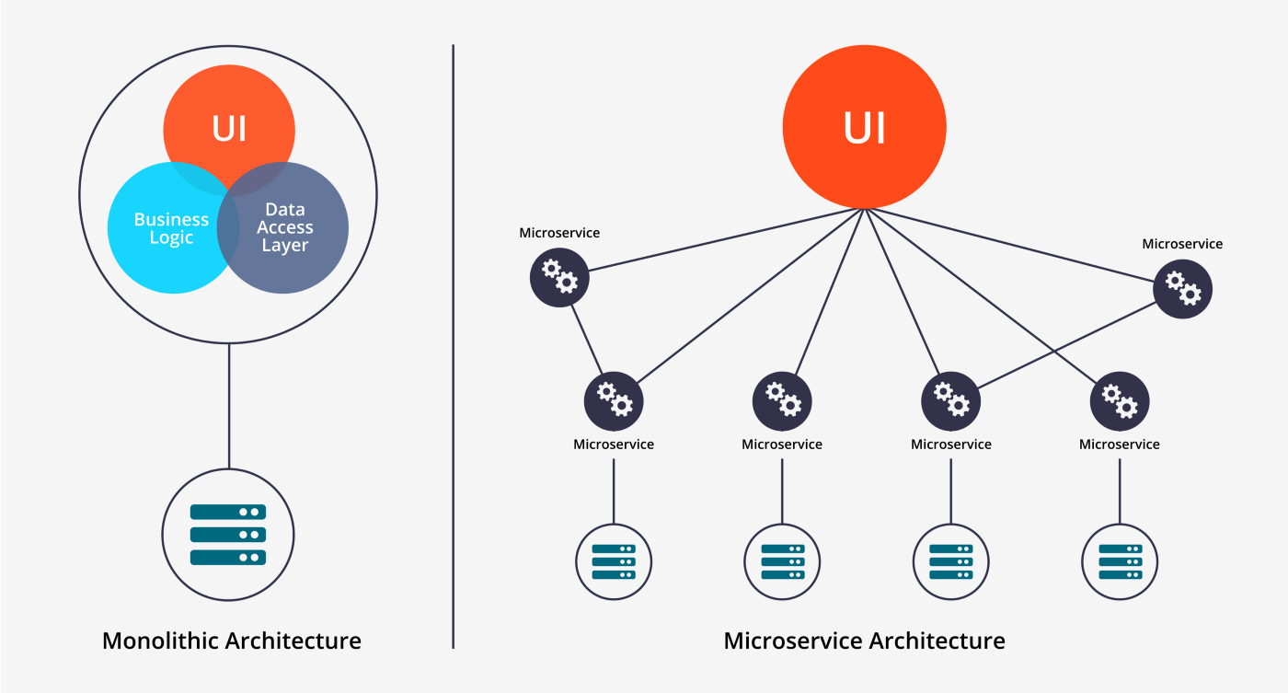
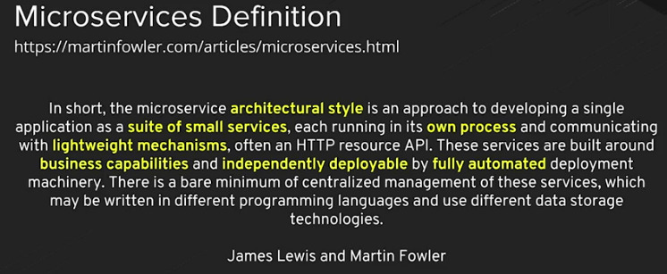
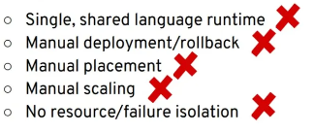
Microservice Architecture
Why use a microservices architecture?
Developers will work on a smaller codebase compared to a larger one in a monolithic app.
Responsibilities of the developers will be more defined.
The application's technology stack can differ through microservices.
Continuous delivery will be easier.
Scalability will be independent to each microservice.
Data can be decentralized.
Isolate failures.
Monolithic vs Microservice architecture.
Monolithic architecture problems
So, where do you put your microservices? In containers.

Slide 7
Microservices and Container: Why it is perfect match
Lower infrastructure footprint.
By running multiple components on a single operating system you reduce overhead, freeing up processing power for your application components.
Better performance than VM. (only if container itself not running in VM)
Better utilization of resources by placing microservices in specific nodes.
Faster instantiation; Leads to faster scaling, Faster recovery than VM.
Pkg sharing between containers lead to reduce image size. (Docker feature , Only specific cases)
Microservices are autonomous in nature which makes is good fit for container
It can deploy autonomously
One container goes down will not impact other.
Container provides isolation of technologies.

Slide 8
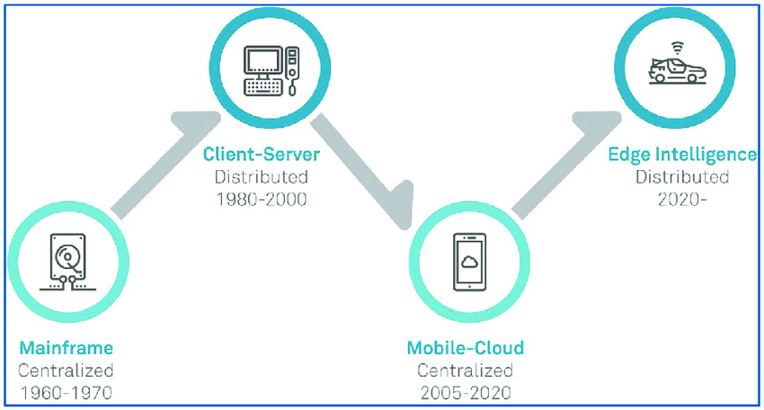
Computing Methodology: Centralized -> Distributed -> Cloud -> Cloud + Edge
Mainframe(Centralized):
what: highly powerful and reliable computing machines, responsible for handling large data such as massive input-output operations.
Why: lack of internet and personal PC/servers, a centralized high computing machine used for computing by multiple users.
Client-Server(Distributed):
What: A client server architecture for data produced by clients and processed by remote servers over internet.
Why: Internet evolve and organization setup their data center to process user data in secure way, not in shared machine like mainframe.
Cloud Computing(Centralized):
What: centralized servers pools to do commuting, offered as service to organizations and public by providers
Why: client server has problem that each enterprise has to maintain infra/IT, with cloud it is reduced and offered flexibilities like pay as you go model.
Edge Computing(Distributed):
What: Compute, storage and networking resource are placed near to users.
Why: with evolving technologies like 5G, emerging use cases like auto driving and latency sensitive apps like AR/VR/MR, gaming etc. need computing near to data produce and meantime provide cloud level flexibilities like scaling, flexibility.
Cloud and Edge will co-exist and Edge computing is not replacement of cloud.

Slide 9
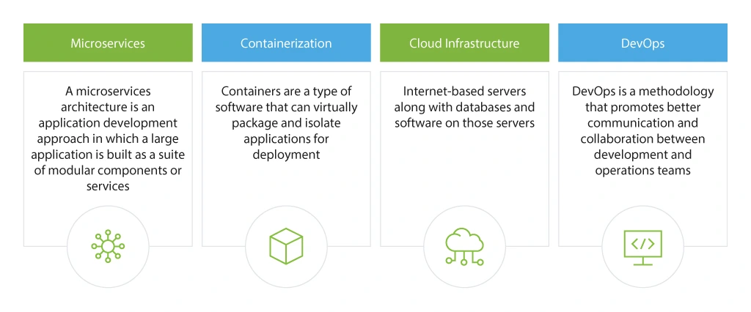
Cloud Computing Building Blocks
Notes:
https://www.techtarget.com/searchcloudcomputing/tip/Explore-cloud-native-vs-cloud-based-vs-cloud-enabled-apps

Slide 10
Deepdive in Container

Slide 11
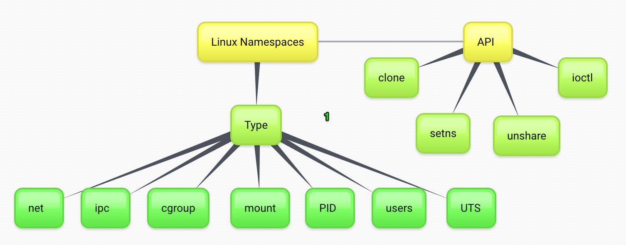

Linux Namespaces
A namespace wraps a global system resource in an abstraction that makes it appear to the processes within the namespace that they have their own isolated instance of the global resource. Changes to the global resource are visible to other processes that are members of the namespace but are invisible to other processes.
One use of namespaces is to implement containers.
Notes:
Pid and users id namespace is nested namespace. Example: PID namespaces are nested, meaning when a new process is created it will have a PID for each namespace from its current namespace up to the initial PID namespace. Hence the initial PID namespace is able to see all processes, albeit with different PIDs than other namespaces will see processes with.

Slide 12
Linux Namespaces (Cont…)
Name Spaces:
pid : The Process ID. This file is a handle for the PID namespace of the process.PID namespaces isolate the process ID number space, meaning that processes in different PID namespaces can have the same PID.
net This file is a handle for the network namespace of the process. This provides the isolation of the system resources associated with networking and isolates Network devices.
mount This file is a handle for the mount namespace of the process and isolates Mount points
ipc This file is a handle for the IPC namespace of the process and isolates System Vs IPC and POSIX message queues
uts This file is a handle for the UTS namespace of the process and isolates Hostname.
user This file is a handle for the user namespace of the process
cgroup the container will have an isolated view of the cgroup hierarchy.
APIS:
clone(): The clone system call creates a new process. If the flags argument of the call specifies one or more of the CLONE_NEW* flags(namespace indicator), then new namespaces are created for each flag, and the child process is made a member of those namespaces.
setns(): The setns system call allows the calling process to join an existing namespace. The namespace to join is specified via a file descriptor that refers to one of the /proc/[pid]/ns files described below.
unshare(): The unshare system call moves the calling process to a new namespace. If the flags argument of the call specifies one or more of the CLONE_NEW* flags(namespace indicator), then new namespaces are created for each flag, and the calling process is made a member of those namespaces.

Slide 13
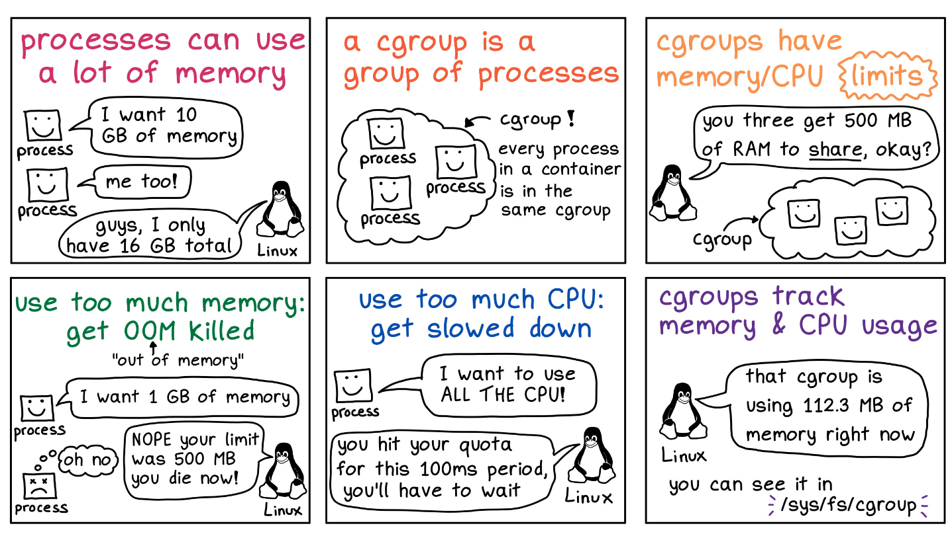
Cgroups
Control cgroups, usually referred to as cgroups, are a Linux kernel feature which allow processes to be organized into hierarchical groups whose usage of various types of resources can then be limited and monitored.

Slide 14
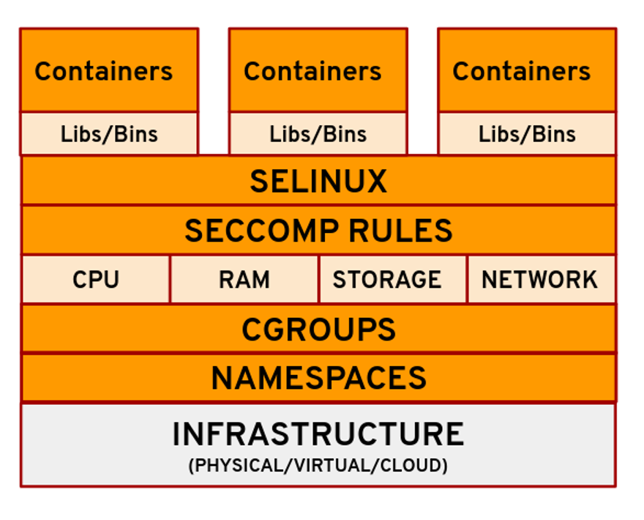
SECCOMP and SELINUX
https://dockerlabs.collabnix.com/advanced/security/seccomp/#:~:text=Docker%20uses%20seccomp%20in%20filter,to%20the%20docker%20run%20command.
https://opensource.com/article/21/8/container-linux-technology
SECCOMP
Seccomp basically stands for secure computing. It is a Linux feature used to restrict the set of system calls that an application is allowed to make. The default seccomp profile for Docker, for example, disables around 44 syscalls (over 300 are available). The idea here is to provide containers access to only those resources which the container might need. For example, if you don't need the container to change the clock time on your host machine, you probably have no use for the clock_adjtime and clock_settime syscalls, and it makes sense to block them out.
When you run a container it gets the default seccomp profile.
SELinux (Optional)
SELinux stands for security-enhanced Linux. SELinux lets you limit an application to have access only to its own files and prevent any other processes from accessing them. So, if an application is compromised, it would limit the number of files that it can affect or control.
You need to instruct your runtime to enable it, also this feature should be enabled in host OS.

Slide 15
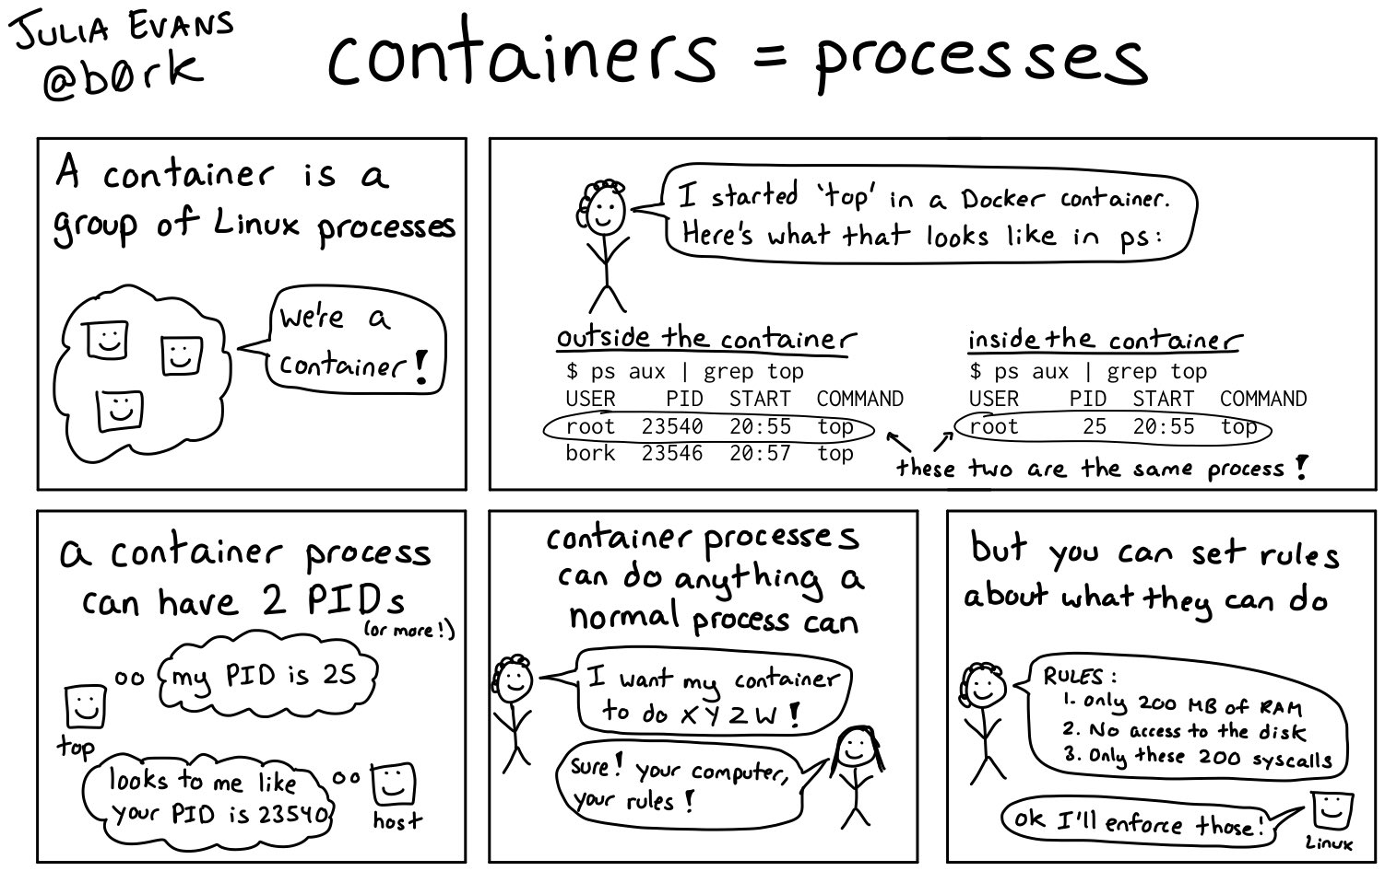
How Containers work
Basically the way containers work are:
1. Start a regular linux process(s)
2. Set a bunch of rules about what that process can do (with cgroups, namespaces, capabilities, seccomp rules)
3. Those rules are what make the process a "container"
Docker(runc) does it for you
Notes:
https://dockerlabs.collabnix.com/advanced/security/seccomp/#:~:text=Docker%20uses%20seccomp%20in%20filter,to%20the%20docker%20run%20command.

Slide 16
Docker
Notes:
What Is CRI?
CRI (Container Runtime Interface) is a plugin interface that allows kubelet to use different container runtimes. Various container runtimes implement the CRI API and this allows users to use the container runtime of their choice in their kubernetes installation.
What is CNI?
CNI project includes a spec to provide a generic plugin-based networking solution for linux containers. It also consists of various plugins which perform different functions in configuring the pod network. A CNI plugin is an executable that follows the CNI spec and we’ll discuss some plugins in the post below.

Slide 17
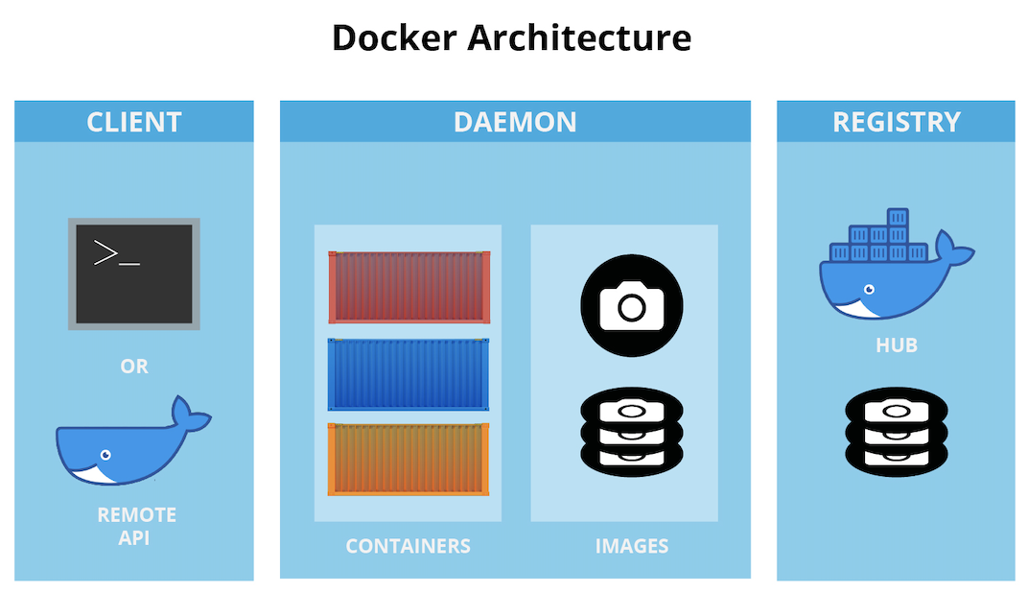
Docker
Docker is a software platform for building applications based on containers.
Docker Client
Docker Daemon
Docker Image
Docker Container
Docker Registry
Highlevel Docker Architecture

Slide 18
Orchestration
In system administration, orchestration is the automated configuration, coordination, and management of computer systems and software. - Wikipedia
In other words Orchestration is the automated configuration, management, and coordination of computer systems, applications, and services. Orchestration helps IT to more easily manage complex tasks and workflows.
Automation and orchestration are different, but related concepts. Automation helps make your business more efficient by reducing or replacing human interaction with IT systems and instead using software to perform tasks in order to reduce cost, complexity, and errors.
In general, automation refers to automating a single task. This is different from orchestration, which is how you can automate a process or workflow that involves many steps across multiple disparate systems. When you start by building automation into your processes, you can then orchestrate them to run automatically.
ONAP [SO] is a network service orchestrator.
Kubernetes is an open source platform that does container/microservices orchestration.
Use container/microservices orchestration to automate and manage tasks such as:
Provisioning and deployment
Configuration and scheduling
Resource allocation
Container availability
Scaling or removing containers based on balancing workloads across your infrastructure
Load balancing and traffic routing
Monitoring container health
Configuring applications based on the container in which they will run
Keeping interactions between containers secure
Notes:
Pause Container holds the network namespace for the pod. Kubernetes creates pause containers to acquire the respective pod’s IP address and set up the network namespace for all other containers that join that pod.
Pause container make sure that there is a network stack to map, and it doesn’t change. Pause containers are a pod implementation detail where one pause container is used for each pod and shouldn’t be shown when listing containers that are members of pods. Pause containers hold the cgroups, reservations, and namespaces of a pod before its individual containers are created. The pause container’s image is always present, so the allocation of the pod’s resources is instantaneous.
By default, pause containers are hidden, but you can see them by running docker ps -a.

Slide 19
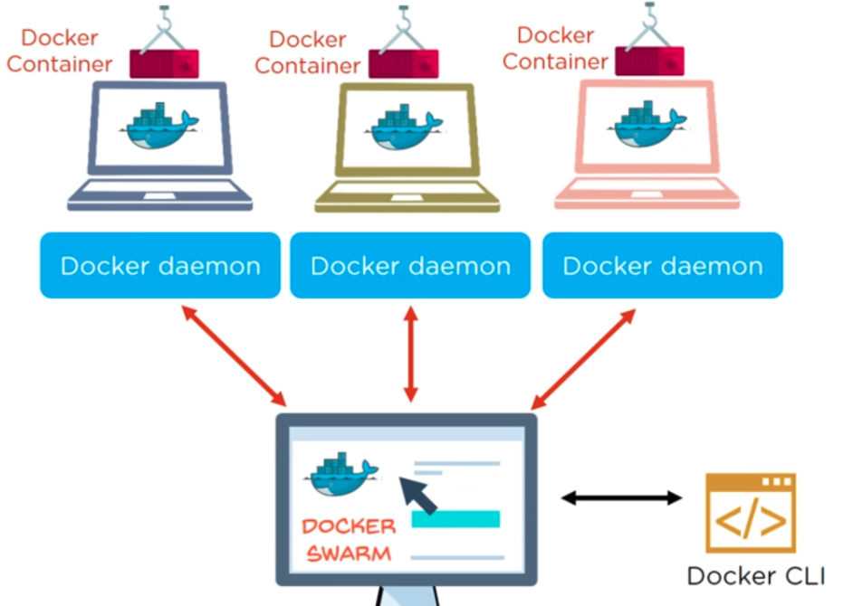
Container Orchestrator: Docker Swarm
Docker swarm is a container orchestration tool, meaning that it allows the user to manage multiple containers deployed across multiple host machines.
A Swarm cluster consists of Docker Engine deployed Swarm manager nodes (which orchestrate and manage the cluster) and worker nodes (which are directed to execute tasks by the manager nodes).
Docker swarm

Slide 20
Kubernetes

Slide 21
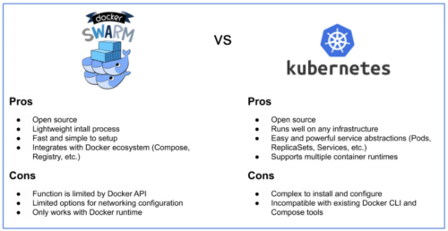
Docker Swarm vs Kubernetes
K8s is the winner here!

Slide 22
Pods

Slide 23
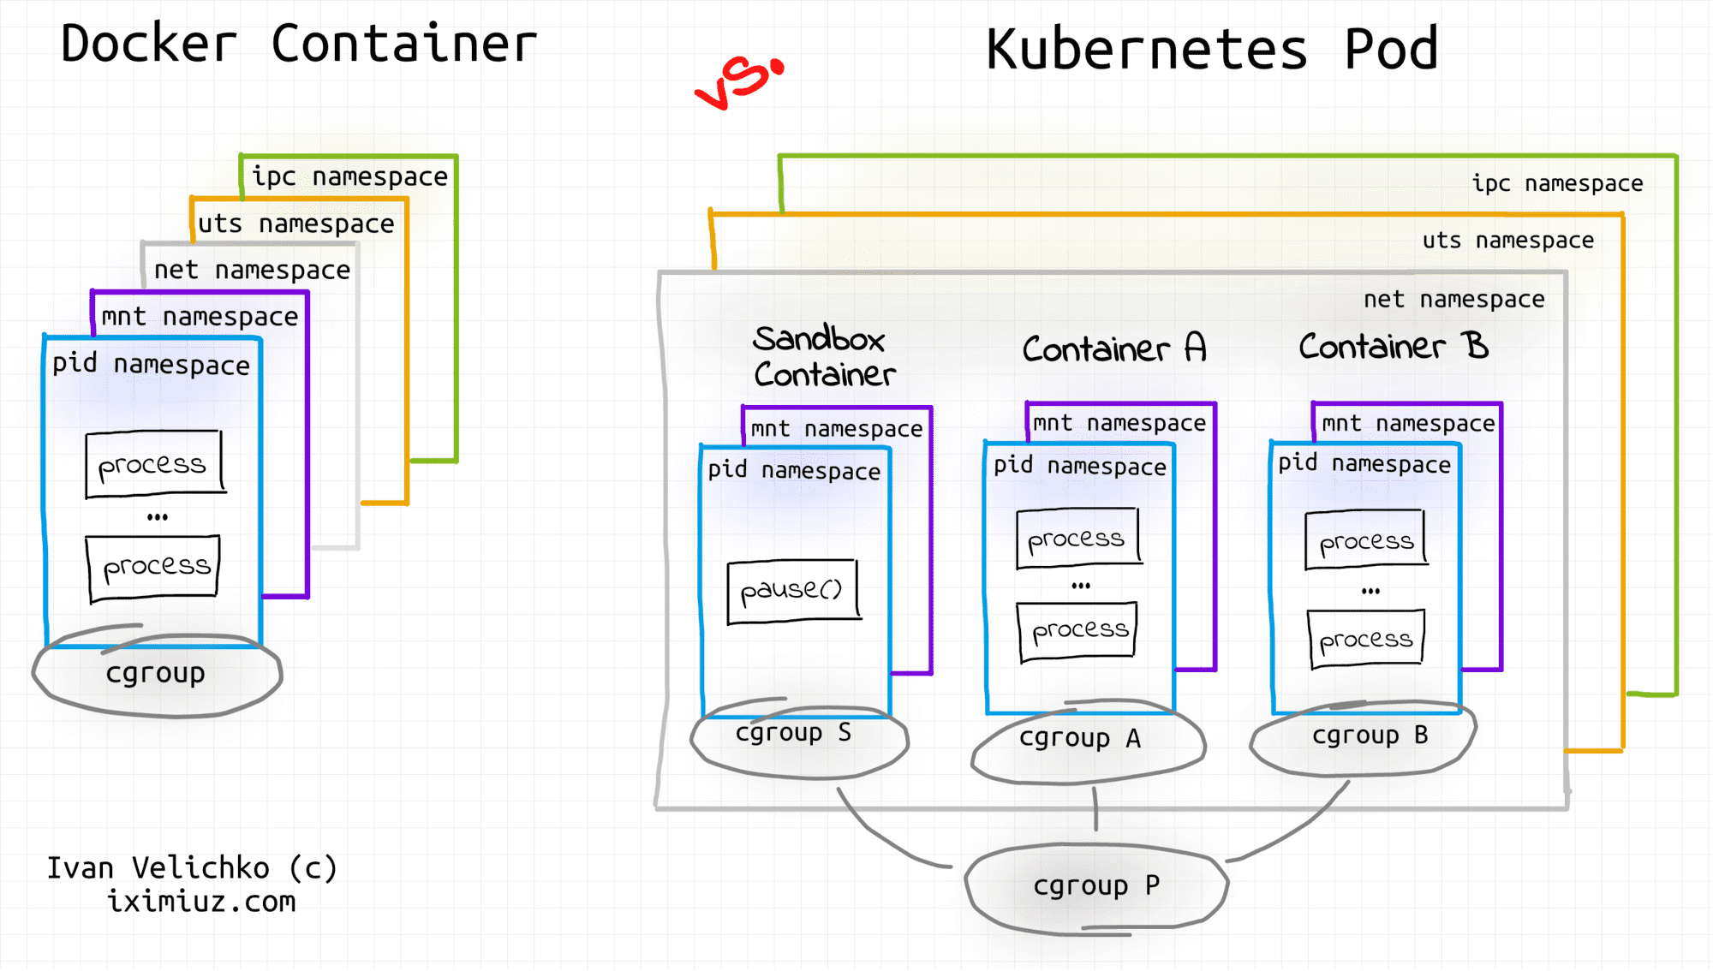
Pods
POD Cgroup: https://medium.com/geekculture/layer-by-layer-cgroup-in-kubernetes-c4e26bda676c
Pods are the smallest, most basic deployable objects in Kubernetes. A Pod represents a single instance of a running process in your cluster.
Pods contain one or more containers, such as Docker containers.
When a Pod runs multiple containers, the containers are managed as a single entity and share the Pod's resources.
Pods also contain shared networking and storage resources for their containers:
Container vs POD
Notes:
Pause Container holds the network namespace for the pod. Kubernetes creates pause containers to acquire the respective pod’s IP address and set up the network namespace for all other containers that join that pod.
Pause container make sure that there is a network stack to map, and it doesn’t change. Pause containers are a pod implementation detail where one pause container is used for each pod and shouldn’t be shown when listing containers that are members of pods. Pause containers hold the cgroups, reservations, and namespaces of a pod before its individual containers are created. The pause container’s image is always present, so the allocation of the pod’s resources is instantaneous.
By default, pause containers are hidden, but you can see them by running docker ps -a.

Slide 24
K8S Cluster Architecture

Slide 25
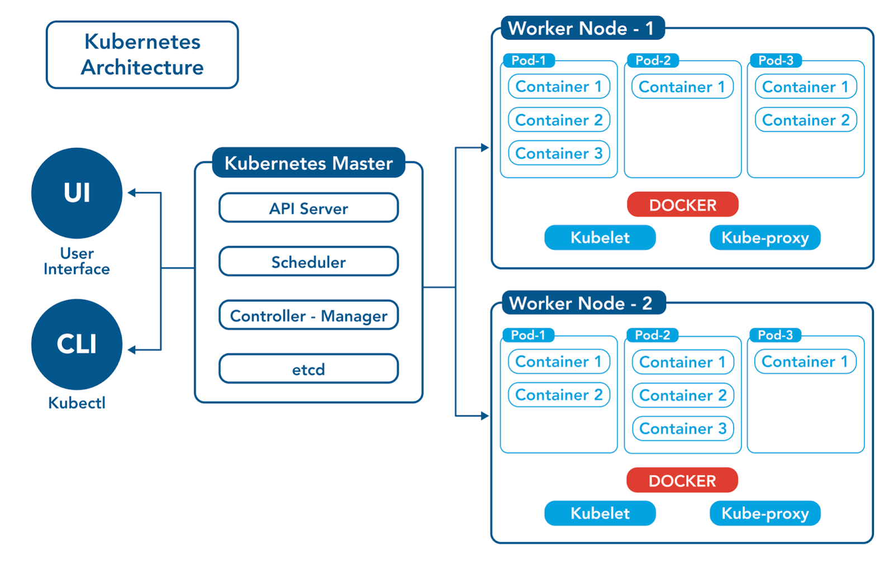
K8S Cluster Architecture
In production environments, the control plane usually runs across multiple computers and a cluster usually runs multiple nodes, providing fault-tolerance and high availability.

Slide 26
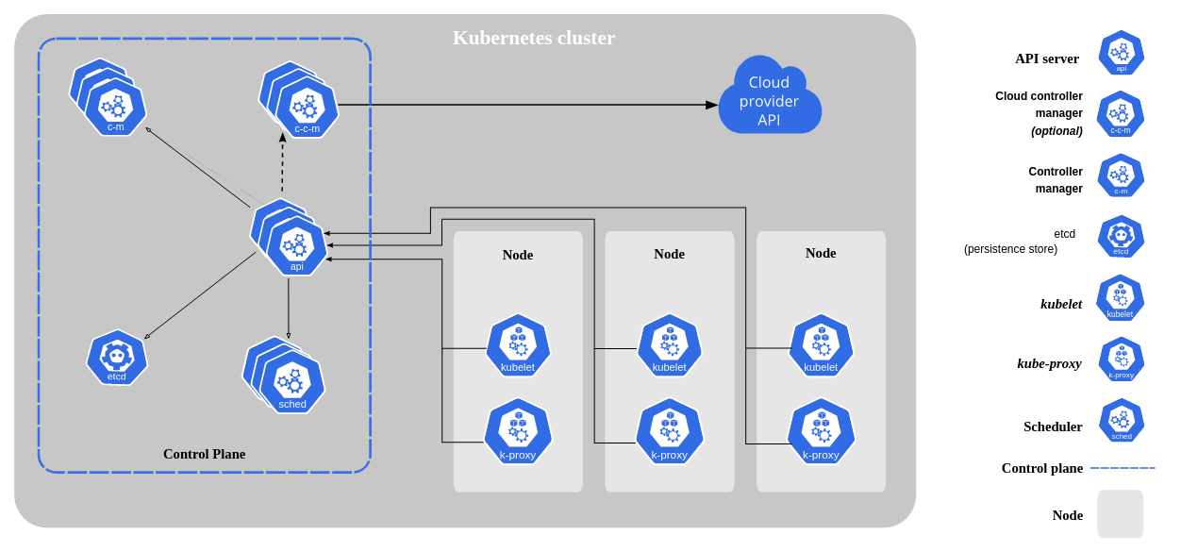
K8S Cluster Architecture

Slide 27
Control Plane Components
API SERVER: The API server is a component of the Kubernetes control plane that exposes the Kubernetes API. The API Server services REST operations and provides the frontend to the cluster's shared state through which all other components interact. The Kubernetes API server validates and configures data for the api objects which include pods, services, replicationcontrollers, and others
ETCD: Consistent and highly-available key value store used as Kubernetes' backing store for all cluster data. If your Kubernetes cluster uses etcd as its backing store, make sure you have a back up plan for those data.
KUBE SCHEDULER: Control plane component that watches for newly created Pods with no assigned node, and selects a node for them to run on. Factors taken into account for scheduling decisions include: individual and collective resource requirements, hardware/software/policy constraints, affinity and anti-affinity specifications, data locality, inter-workload interference, and deadlines.

Slide 28
Control Plane Components
KUBE CONTROLLER MANAGER: Control plane component that runs controller processes. Logically, each controller is a separate process, but to reduce complexity, they are all compiled into a single binary and run in a single process. Some types of these controllers are:
Node controller: Responsible for noticing and responding when nodes go down.
Job controller: Watches for Job objects that represent one-off tasks, then creates Pods to run those tasks to completion.
Endpoints controller: Populates the Endpoints object (that is, joins Services & Pods).
Service Account & Token controllers: Create default accounts and API access tokens for new namespaces.
CLOUD CONTROLLER MANAGER: A Kubernetes control plane component that embeds cloud-specific control logic. The cloud controller manager lets you link your cluster into your cloud provider's API. This controller is to call cloud provider API from the cluster.

Slide 29
Node Components
KUBELET: Each compute node contains a kubelet, a tiny application that communicates with the control plane. The kublet makes sure containers are running in a pod. When the control plane needs something to happen in a node, the kubelet executes the action.
KUBEPROXY: Each compute node also contains kube-proxy, a network proxy for facilitating Kubernetes networking services. The kube-proxy handles network communications inside or outside of your cluster—relying either on your operating system’s packet filtering layer, or forwarding the traffic itself.
CONTAINER RUNTIME: The container runtime is the underlying software that is used to run containers. Kubernetes supports several runtimes: Docker, containerd, cri-o, rktlet, and any implementation of the Kubernetes CRI (Container Runtime Interface).

Slide 30
Add-on Components
Add-ons extend the functionality of Kubernetes. Addons use Kubernetes resources (DaemonSet, Deployment, etc) to implement cluster features.
CNI: You must deploy a Container Network Interface (CNI) based Pod network add-on so that your Pods can communicate with each other. Cluster DNS (CoreDNS) will not start up before a network is installed.
CoreDNS: All Kubernetes clusters should have a DNS server, as many examples rely on it. Kubernetes creates DNS records for services and pods. You can contact services with consistent DNS names instead of IP addresses.
Kubernetes DNS schedules a DNS Pod and Service on the cluster, and configures the kubelets to tell individual containers to use the DNS Service's IP to resolve DNS names. Every Service defined in the cluster (including the DNS server itself) is assigned a DNS name.
Other Add ons includes dashboard, container resource monitoring, etc.

Slide 31

Component interaction flow (Pod create)
kubectl run nginx --image=nginx
kubectl or any other API client submits the Pod spec to the API server.
The API server writes the Pod object to the etcd data store. Once the write is successful, an acknowledgment is sent back to API server and to the client.
The kube-scheduler (via its watcher) sees that a new Pod object is created on API server but is not bound to any node.
kube-scheduler assigns a node to the pod and updates the API server.
This change is then propagated to the etcd data store. The API server also reflects this node assignment on its Pod object.
Kubelet on every node also runs watchers who keep watching API server. Kubelet on the destination node sees that a new Pod is assigned to it.
Kubelet starts the pod on its node by calling Docker and updates the container state back to the API server.
The API server update the pod state into etcd.
Once etcd sends the acknowledgment of a successful write, the API server sends an acknowledgment back to kubelet indicating that the event is accepted.
Api server
Kube proxy
kubelet
etcd
runtime
Scheduler
Kube proxy
kubelet
Controller Manager
runtime

Slide 32
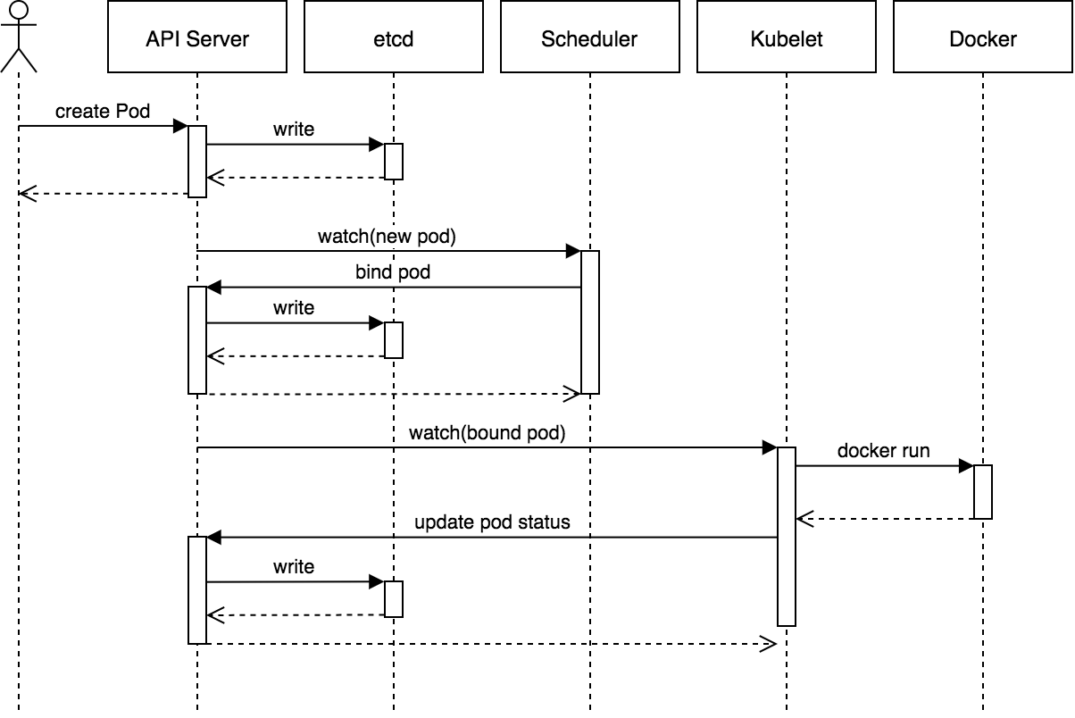
Component interaction flow (Pod create) (Another view)

Slide 33
K8S Installation

Slide 34
Prerequisites
For control plane, a compatible Linux host. The Kubernetes project provides generic instructions for Linux distributions based on Debian and Red Hat, and those distributions without a package manager.
2 GB or more of RAM per machine (any less will leave little room for your apps).
2 CPUs or more.
Full network connectivity between all machines in the cluster (public or private network is fine).
Unique hostname, MAC address, and product_uuid for every node. Kubernetes uses these values to uniquely identify the nodes in the cluster. If these values are not unique to each node, the installation process may fail.
Certain ports are open on your machines. See here for more details.
Swap disabled. You MUST disable swap in order for the kubelet to work properly.

Slide 35
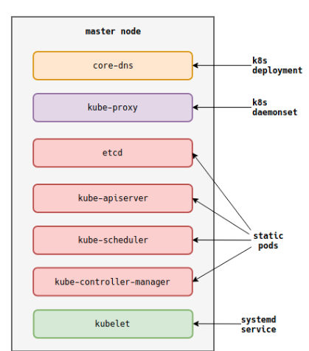
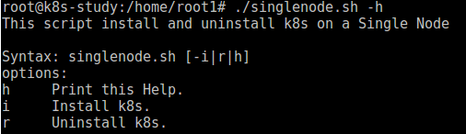
Hands On
Download script from https://github.com/swarupn/k8sworkshop
Some useful commands:
kubectl get nodes
kubectl describe nodes (Discuss)
Diagram showing components created by “kubeadm init” command
Notes:
2 CoreDNS: Two Replicas are for high availability (reduce the risk of CoreDNS downtime) and default value at install time.

Slide 36
Kubeadm init
kubeadm runs a series of pre-flight checks to validate the system state before making changes. Some checks only trigger warnings, others are considered errors and will exit kubeadm until the problem is corrected or the user specifies --skip-preflight-checks
preflight Run pre-flight checks
certs Certificate generation
/ca Generate the self-signed Kubernetes CA to provision identities for other Kubernetes components
/apiserver Generate the certificate for serving the Kubernetes API
/apiserver-kubelet-client Generate the certificate for the API server to connect to kubelet
/etcd-ca Generate the self-signed CA to provision identities for etcd
. . .
kubeconfig Generate all kubeconfig files necessary to establish the control plane and the admin kubeconfig file
/admin Generate a kubeconfig file for the admin to use and for kubeadm itself
/kubelet Generate a kubeconfig file for the kubelet to use *only* for cluster bootstrapping purposes
/controller-manager Generate a kubeconfig file for the controller manager to use
/scheduler Generate a kubeconfig file for the scheduler to use
kubelet-start Write kubelet settings and (re)start the kubelet
kubeadm generates a self-signed CA to provision identities for each component.
If the user has provided their own CA by dropping it in the cert directory (configured via --cert-dir, by default /etc/kubernetes/pki), this step is skipped.
Craeting a kubeconfig file for the kubelet to use to connect to the API server, as well as an additional kubeconfig file for administration.
Start kubelet process under systemd.

Slide 37
Kubeadm init (Cont…)
control-plane Generate all static Pod manifest files necessary to establish the control plane
/apiserver Generates the kube-apiserver static Pod manifest
/controller-manager Generates the kube-controller-manager static Pod manifest
/scheduler Generates the kube-scheduler static Pod manifest
etcd Generate static Pod manifest file for local etcd
/local Generate the static Pod manifest file for a local, single-node local etcd instance
upload-config Upload the kubeadm and kubelet configuration to a ConfigMap
/kubeadm Upload the kubeadm ClusterConfiguration to a ConfigMap
/kubelet Upload the kubelet component config to a ConfigMap
upload-certs Upload certificates to kubeadm-certs
mark-control-plane Mark a node as a control-plane
bootstrap-token Generates bootstrap tokens used to join a node to a cluster
kubelet-finalize Updates settings relevant to the kubelet after TLS bootstrap
/experimental-cert-rotation Enable kubelet client certificate rotation
addon Install required addons for passing conformance tests
/coredns Install the CoreDNS addon to a Kubernetes cluster
/kube-proxy Install the kube-proxy addon to a Kubernetes cluster
Generates Kubernetes static Pod manifests for the API server, controller manager and scheduler. It places them in /etc/kubernetes/manifests. The kubelet watches this directory for Pods to create on startup. These are the core components of Kubernetes. Once they are up and running kubeadm can set up and manage any additional components.
Upload the kubeadm ClusterConfiguration to a ConfigMap called kubeadm-config, Upload kubelet configuration extracted from the kubeadm InitConfiguration object to a ConfigMap of the form kubelet-config-1.X in the cluster. This helps in maintain version and upgrade version.
kubeadm “taints” the master node so that only control plane components will run there.
Generates bootstrap tokens used to join a node to a cluster
Updates settings relevant to the kubelet after TLS bootstrap
Installs add-on components via the API server. Right now this is the internal DNS server and the kube-proxy DaemonSet.

Slide 38
Kubeadm join
On master (Optional)
$ kubeadm token create --print-join-command
On To be worker node:
$ kubeadm join 10.128.0.11:6443 --token q0ezwe.grf019c1o4f4cepq --discovery-token-ca-cert-hash sha256:438908d596ef5b0e4b27e1bb485a4dcf9cba4877cd848009c36685acbd2ccb6d
Preflight checks, kubeadm downloads necessary cluster information from the API server. It uses the bootstrap token and the CA key hash to verify the authenticity of that data.
preflight Run join pre-flight checks
kubelet-start Write kubelet settings, certificates and (re)start the kubelet
Once the cluster information is known, kubelet can start the TLS bootstrapping process. Once completed kubeadm configures the local kubelet to connect to the API server with the definitive identity assigned to the node.

Slide 39
THANK YOU

Slide 40
Backup Slides

Slide 41
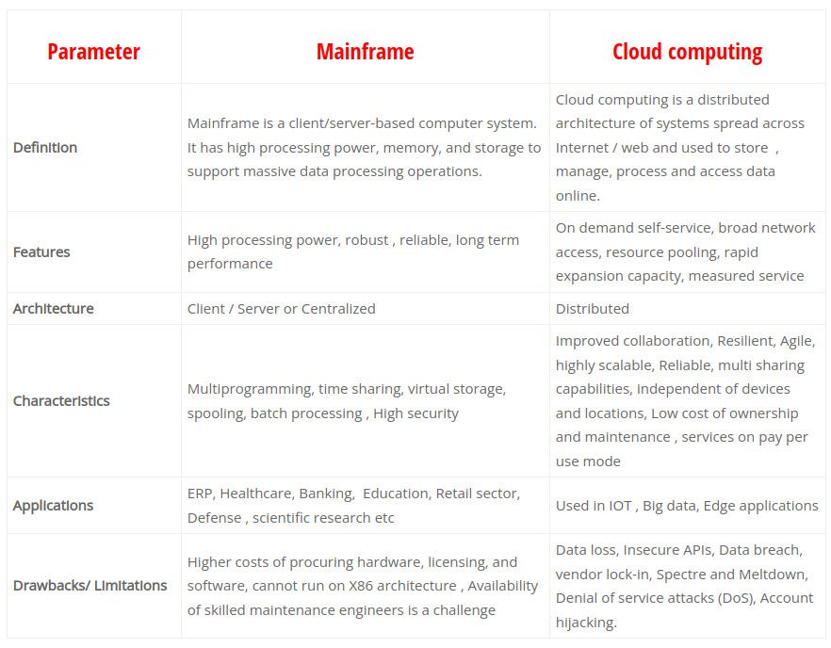
Mainframe vs Cloud

Slide 42
Linux Namespaces vs K8s Namespaces
In Kubernetes, namespaces provides a mechanism for isolating groups of resources within a single cluster.
It does this by providing the following:
A scope for Names.
A mechanism to attach authorization and policy to a subsection of the cluster.
Use of multiple namespaces is optional.
Kubernetes namespaces are comparable to Linux namespaces. However, Kubernetes manages namespaces in a declarative style. The simple clean-up process is central to managing operations at scale and the cluster management add-ons such as role-based access control (RBAC), making namespaces even more powerful.

Slide 43
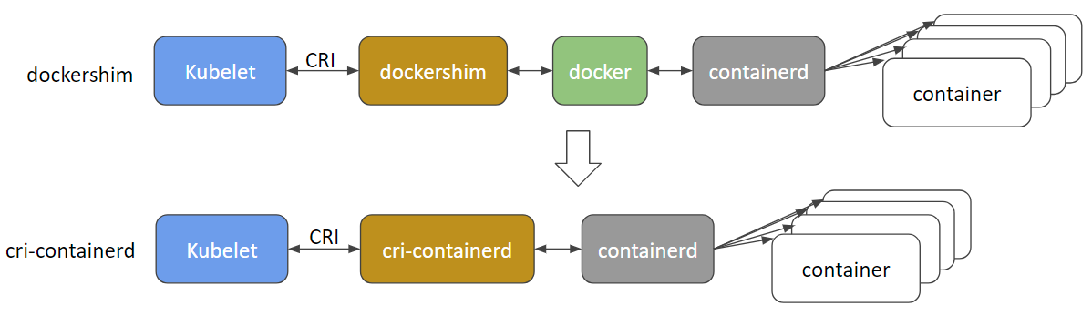
Container Runtime Interface
Kubelet CRI interaction
The CRI is an interface that must be implemented by every "high-level" runtime willing to manage containers. This can be Docker but also Containerd or CRI-O. This interface is defined with the protobuf dialect and communications are done through gRPC between the Kubelet and these container runtime managers.
Runtime | Path to Unix domain socket
Docker | /var/run/dockershim.sock
containerd | /run/containerd/containerd.sock
CRI-O | /var/run/crio/crio.sock

Slide 44
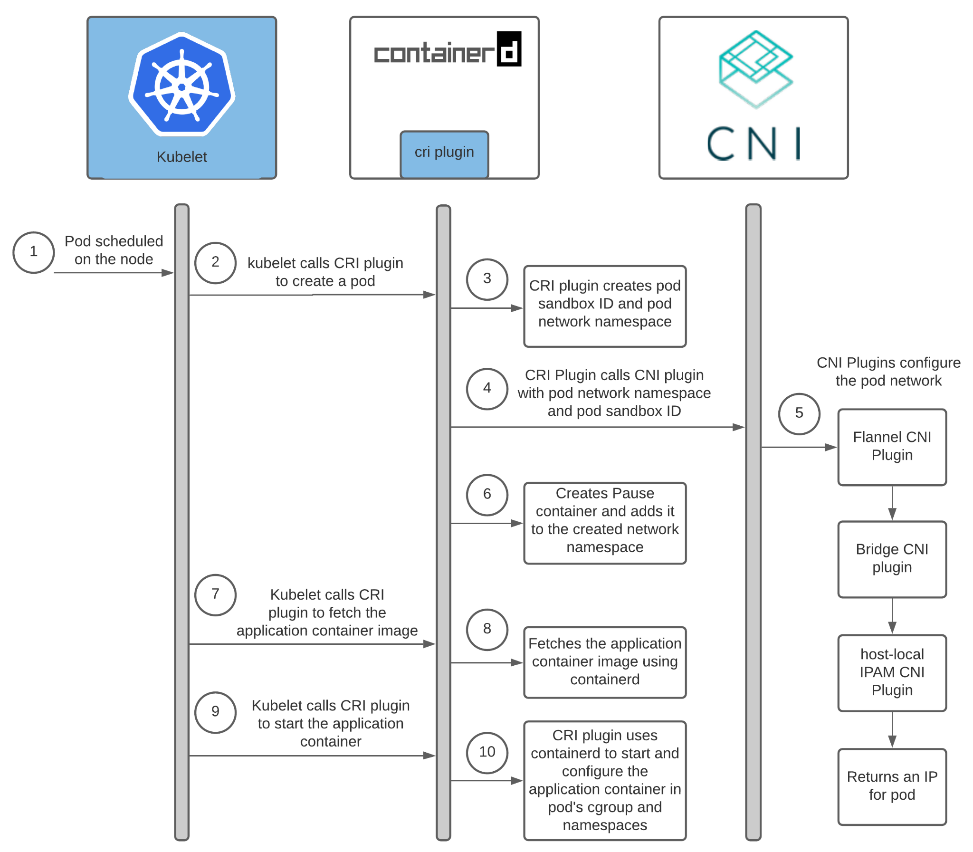
Container Networking Interface
Container Network Interface (CNI) is a framework for dynamically configuring networking resources. It uses a group of libraries and specifications written in Go. The plugin specification defines an interface for configuring the network, provisioning IP addresses, and maintaining connectivity with multiple hosts.
When used with Kubernetes, CNI can integrate smoothly with the kubelet to enable the use of an overlay or underlay network to automatically configure the network between pods.
CNIs define the underlying network which can be used for communicating the various component of kubernetes.
While kube-proxy is a tool to generate the IP tables magic which let you connect to any of the pod(using services) in kubernetes no matter on which node that pod exist
Kubelet CRI CNI interaction

Slide 45
K8s Preflight Checks
Root user check : This check verifies that the user executing kubeadm is root user. It does so by checking UID of a current user.
System Verification Check : This check performs multiple other checks. It checks that OS is Linux by comparing a value of “uname”. It checks kernel release value with one specified in specs. It also checks for various kernel configurations by loading kernel config from specified path or loading kernel config module if file not found. Next check is for existence of “cpu”, “cpuacct”, “cpuset”, “devices”, “freezer”, “memory” CGroups currently. The last check it performs in this category is for Docker. It checks specific version of Docker and Graph driver it uses. Currently it checks for “aufs”, “overlay”, “devicemapper”.
Hostname Check : It checks hostname of node. It should be in lower case and reachable.
Service Checks : It verifies that services are loaded and active if specified. Currently it checks for Docker and Kubelet services.
Firewall Check : It checks if firewalld is active.
Port Checks : It checks for ports 6443, 10250, 10251 and 10252 currently.
HTTP Proxy Check : It check if host is behind proxy.
Directory Checks : It checks if directories are available and empty. If they are not empty then it throws error. Currently it checks for kubernetes manifest directory and /var/lib/kubelet.
File Content Check : It checks for value of file /proc/sys/net/bridge/bridge-nf-call-iptables. It should contain a value 1. It can be set temporary by using sysctl command or permanently by setting that parameter to /etc/sysctl.conf file.
Executable Existence Checks : In these checks it looks up for various executable in PATH. Currently it checks for ip, iptables, mount, nsenter, ebtables, ethtool, socat, tc and touch executable.
Extra Arguments Checks : It checks for validity of extra arguments for API Server, Controller Manager and Scheduler currently.
Etcd Check : It checks for version of etcd.
Authorization Mode Checks : It checks for config for specified authorization mode. If mode is ABAC then it checks for <kubernetes_directory>/abac_policy.json. If it is WebHooks then it looks for <kubernetes_directory>/webhook_authz.conf.

Slide 46
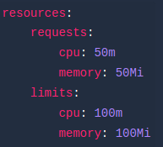
Concepts of resource and limits
To make full use of resources in a Kubernetes cluster and improve scheduling efficiency, Kubernetes uses requests and limits to control resource allocation for containers. Each container can have its own requests and limits. These two parameters are specified by resources.requests and resources.limits.
Requests define the smallest amount of resources a container needs.
Limits determine the maximum amount of resources that a container can use, preventing resource shortage or machine crashes due to excessive resource consumption. If it is set to 0, it means no resource limit for the container.
In particular, if you set limits without specifying requests, Kubernetes considers the value of requests is the same as that of limits by default.
If services in a Pod are using more CPU resources than the limits specified, the Pod will be restricted but will not be killed. If no limit is set, a Pod can use all idle CPU resources.
If a Pod is using more memory resources than the limits specified, container processes in the Pod will be killed due to OOM. In this case, Kubernetes tends to restart the container on the original node or simply create another Pod.
0 <= requests <=Node Allocatable; requests <= limits <= Infinity.

Slide 47
What We can further Study
How kubernetes support High availability in control plane.

Slide 48
Exercise
Upgrade the script to support multi node.

Slide 49
Useful Links
https://www.youtube.com/watch?v=BgrQ16r84pM
https://www.ianlewis.org/en/how-kubeadm-initializes-your-kubernetes-master
https://kubernetes.io/docs/concepts/
https://kubernetes.io/docs/reference/setup-tools/kubeadm/kubeadm-init/
https://www.nginx.com/blog/what-are-namespaces-cgroups-how-do-they-work/
https://medium.com/google-cloud/kubernetes-101-pods-nodes-containers-and-clusters-c1509e409e16
https://learnk8s.io/troubleshooting-deployments

